Slide 1
ENERGY RESOURCES
G.H.PATEL COLLEGE OF ENGG. & TECH. (011), VALLABH VIDYANAGAR
GUIDED BY PROF. SNEHAL POPLI
CIVIL & STRUCTURAL ENGG DEPT

Slide 2
Group Members
29. YASH DALAL -130110119011
VINAY SUDANI- 130110119056
ARUN PATEL- 130110119035
PARIMAL PATEL - 130110119041
ADRIAN FERNANDIS- 130110119017
KARAN CHUNAVALA- 130110119009
PRATIK PARMAR- 130110119033

Slide 3
Introduction
Energy = Working capacity
All types of work like ,pushing, pulling and etc
Forms of Energy
Mechanical
Thermal
Chemical
Biological

Slide 4
WORLD WIDE ENERGY SOURCES USE(2004)

Slide 5
ENERGY RESOURCES
COMMERCIAL & NON COMMERCIAL
PRIMARY & SECONDARY
CONVENTIONAL & NON CONVENTIONAL
RENEWABLE & NON RENEWABLE

Slide 6
INDIAN SCENARIO
INDIA IS THE THIRD LARGEST PRODUCER OF COAL IN WORLD
IN INDIA ,MANY TYPES OF COAL FOUND
GONDWANA
TERTIARY
LIGNITE
INDIA ALSO DEPANDS ON PETROLEUM AND NATURAL GAS

Slide 7
INDIAN SCENARIO
COAL
OIL
ITS CALORIFIC VALUE IS 5550 KCAL/KG
THE COAL RESERVES OF INDIA ARE ESTIMATED ABOUT 110 MILLION METRIC TONES
IN INDIA OIL FIELDS ARE DISTRIBUTED IN GUJRAT PLAINS ,ASSAM ,COASTAL STRIPS ,ETC

Slide 8
GAS
A TOTAL OF 78.4 BILLION CUBIC METERS CAN BE CONSIDERED AS PROVEN RESERVES WHILE A FIGURE OF 170 BILLION CUBIC METER CAN BE GIVEN AS PROBABLE RESERVES MAKING A TOTAL OF 293.4 BILLION CUBIC METER OF GAS WHICH AMOUNTS 1.5 BILLION TONES OF COAL EQUIVALENT.

Slide 9
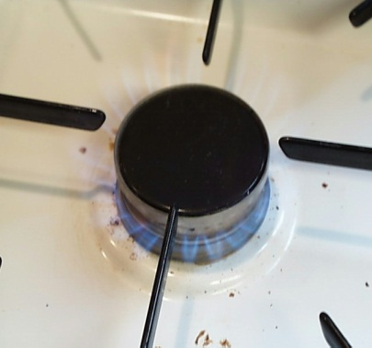
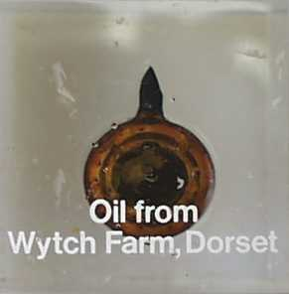
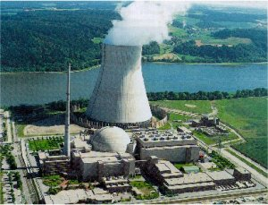
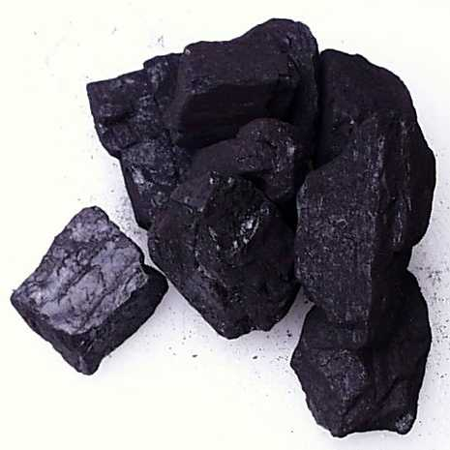
CONVENTIONAL ENERGY SOURCE
COAL
PETROLEUM
NATURAL GAS
NUCLEAR GAS
NUCLEAR ENERGY

Slide 10
ADVANTAGES OF CONVENTIONAL ENERGY SOURCES
EASY TO STORE
AVAILABLE IN HIGHLY CONCENTRATED FORM
RELIABLE SUPPLY
LOWER COST PER UNIT OF ENERGY PRODUCED AS THE TECHONOLOGY IS MATURED.

Slide 11
DISADVANTAGES
LIMITED SUPPLY AND WILL ONE DAY GET EXHAUSTED.
HIGH RUNNING COST
EXTRACTION OF FOSSIL FUELS CAUSE VARIOUS POLLUTION.
HIGHLY POLLUTING.
AVAILABLE IN FEW PLACES.

Slide 12
ENVIRONMENTAL IMPACT OF COAL BASED THERMAL POWER PLANT
Coal based power plants are the major source of air pollution and also a source for thermal pollution.
Coal are major contributors of green house gases and also pollutants responsible for acid rain.

Slide 13
Emission from thermal power plants
The main emission of coal are carbon dioxide, oxide nitrogen, sulphur dioxide, fly ash and also traces of radioactive elements.
Coal combustion is the emission of particulates that have serious impact on health.it can lead to increase problems like asthma, chronic, bronchitis, airway obstruction.
Coal also contains low levels of uranium, thorium and other radio active isotopes whose release environment leads to radioactive contamination. A 1000 MW coal based power plant could release as much as 5.2 tons/year of uranium and 12.8 tons/year of thorium.

Slide 14
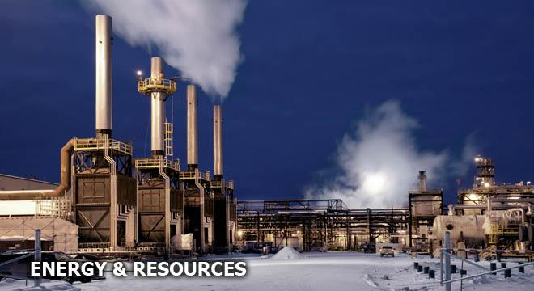

Slide 15
ENVIRONMENTAL IMPACTS OF NUCLEAR POWER PLANTS
Nuclear power plants generate large amount of deadly radioactive waste.
Nuclear waste produce in power plant it can cause many problem of all organism.
All organisms are affected from the radioactive pollution. the effect may be somatic or grnrtic damage. The effect are cancer, shortening of life soan, mutation in the DNA, miscarriages, eye cataract etc.

Slide 16
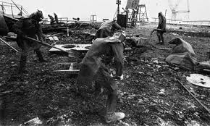
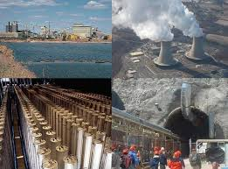

Slide 17
NON-CONVENTIONAL ENERGY RESOURCES
Hydropower
Solar Energy
Wind Energy
Geo-Thermal Energy
Tidal Energy
Biomass Energy
Hydrogen Energy and Fuel Energy

Slide 18
ADVANTAGES OF NON-CONVENTIONAL ENERGY SOURCES
Wide availability
Decentralized power production
Available for the foreseeable future.
Lower running cost
Low pollution

Slide 19
DISADVANTAGES
Unreliable supply
Very difficult to store
Usually produce in small quantities
Currently per unit cost of energy is more compared to other types.

Slide 20
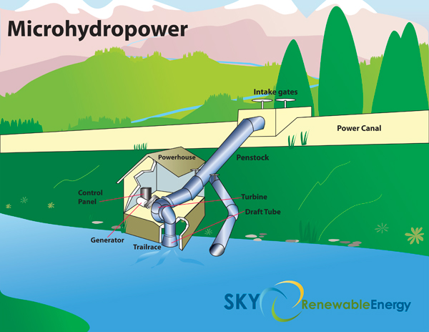

Slide 21
ADVANTAGES OF HYDROPOWER
Longer life
Minimum operating staff.
Can be started very quickly and stopped also.
Saves scarce fuel reserves
Non polluting and hence environmental friendly.
Low cost of generation and maintenance

Slide 22
PROBLEMS WHICH AFFECT THE HYDROPOWER GENERATION IN INDIA
Land acquisition
Environmental aspects
Rehabilitation
Seismic activity
Initial investment

Slide 23
SOLAR ENERGY
INDIA IS IDEAL COMBINATION OF SOLAR ENERGY AND ITS USE.
IN INDIA,THE DESERT OF GUJRAT IS MAIN PLACE FOR ACHIVING SOLAR ENERGY
THAR DESERT CAN GENERATE 700 GW – 2100 GW
INDIA WAS READY TO LAUNCH ITS NATIONAL SOLAR MISSION UNDER THE NATIONAL ACTION PLAN ON CLIMATE CHANGE WITH PLANS TO GENRATE 1000 MW OF POWER BY 2013.
THE AMOUNT OF SOLAR ENERGY IS PRODUCE IN INDIA IS LESS THAN 1%
HOWEVER ,AS OF OCTOMBER 2009 INDIA IS CURRENTLY RANKED NO ONE ALONG WITH USA IN TERMS OF SOLAR ENERGY PRODUCTION PER WATT INSTALLED.
THE SOLAR ENERGY CONVERT INTO ELECTRIC ENERGY WITH THE TOOL OF SOLAR PANEL OF SOLAR CELL.
IT IS CONVENTIONAL ENERGY ,RENEWABLE ENERGY AND POLLUTION LESS ENERGY

Slide 24
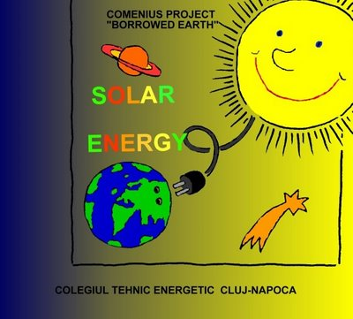

Slide 25
SOLAR ENERGY SYSTEM USE IN INDIA
WATER HEATER(DOMESTIC) | 10000
WATER HEATER | 5000
SOLAR COOLERS | 250000
SOLAR STILLS | 10000
SOLAR HATS | 200

Slide 26
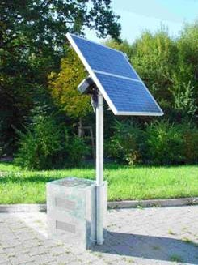
APPLICATION OF SOLAR ENERGY
Solar water heating.
Solar drying of agricultural and animal products.
Solar distillation.
Solar cookers.
Solar engines for water pumping.
Solar furnaces.
Solar green houses.

Slide 27
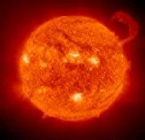
ADVANTAGES
Easy installation and maintenance.
Absence of noise and other form of pollution.
Long life of SPV systems make them favorable for use in remote and isolated areas, forest, hilly and desert regions.

Slide 28


Slide 29
LIMITATIONS
Amount of sunlight that arrives at the earth’s surface is not constant. It depends on location, time of day, time of year and weather conditions.
Uncertainty of availability of solar enengy due to clouds, wind, rainfall etc.

Slide 30
Power Towers
Power tower in Barstow, California.

Slide 31
WIND ENERGY
It Blows You Away
WIND ENERGY POTENTIAL , IN INDIA IS 25000 MW
ABOUT 6000 MW IS LOCATED IN TAMIL NADU AND 5000 MW IN GUJARAT

Slide 32
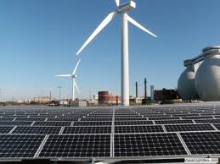

Slide 33
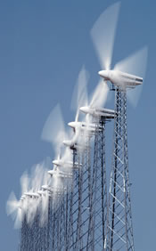
TYPES OF WIND MILLS
Multiblade type wind mill
Sail type wind mill
Propeller type wind mill
Savonius type wind mill
Darrieus type wind mill

Slide 34
ADVANTAGES OF WIND MILLS
Non polluting and environment. friendly source if energy
Important renewable and sustainable source of energy.
Generation period is low.
Cheaper.
Easily available in many off-shore , on-shore and remote areas.

Slide 35
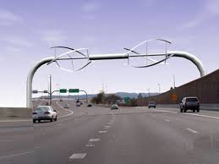

Slide 36
LIMITATIONS
Low energy density.
Favourable in geographic locations which are away from cities.
Variable, unsteady, irregular, intermittent, erratic and dangerous.
Wind turbine design, manufacture and installation have proved to be complex due to widely varying atmospheric conditions.
Located only in vast open areas.
Economical only on a small scale.

Slide 37
BIO MASS ENERGY
Biomass , defined as living matter or its residues.
It includes all the new plant growth, residues and biodegradable organic effluents from industries like sugar ,slaughter house, meat packing plants, distilleries etc.

Slide 38
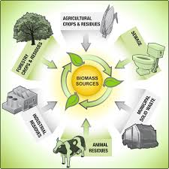
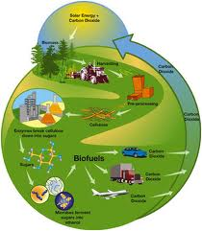

Slide 39
Biomass resources fall into three categories:
1) Biomass in its traditional solid mass (wood and agricultural residue)
2) Biomass in non traditional from (converted to liquid fuels).
3) To ferment the biomass anaerobically to obtain a gaseous fuel called biogas.
BIOGAS 55 to 65% CH4
30 to 40% Co2
Rest -- Impurities
i.e. H2 ,H2S, N2

Slide 40
IN ,INDIA BIO GAS PRODUCTION HAS BECOME VERY COMMON PARTICULARLY IN RURAL AREAS
A 100 KW GASIFIED SYSTEM HAS BEEN ESTABLISHED AT PORT BLAIR
A 10 MW RICE STRAW BASED THERMAL POWER PLANT HAS BEEN COMMISSIONED BY BHEL AT JHALKHARI IN PUNJAB.

Slide 41
SOURCES OF BIOGAS
Sewage
Crop residue
Vegetable residue
Water hyacinth
Poultry droppings
Algae
Ocean keep
Cattle waste

Slide 42
ADVANTAGES
Plants ensures a continuously supply of energy due to their continuous growth.
Potential for rural areas.
Biogas can be used for cooking purpose.
For operating small engines for pumping water.
For lighting.
Wastes can be used as an excellent fertiltzer.

Slide 43


Slide 44
LIMITATION OF BIOMASS ENERGY
Except biogas, the other biomass energy sources have to be establish a significant role.

Slide 45
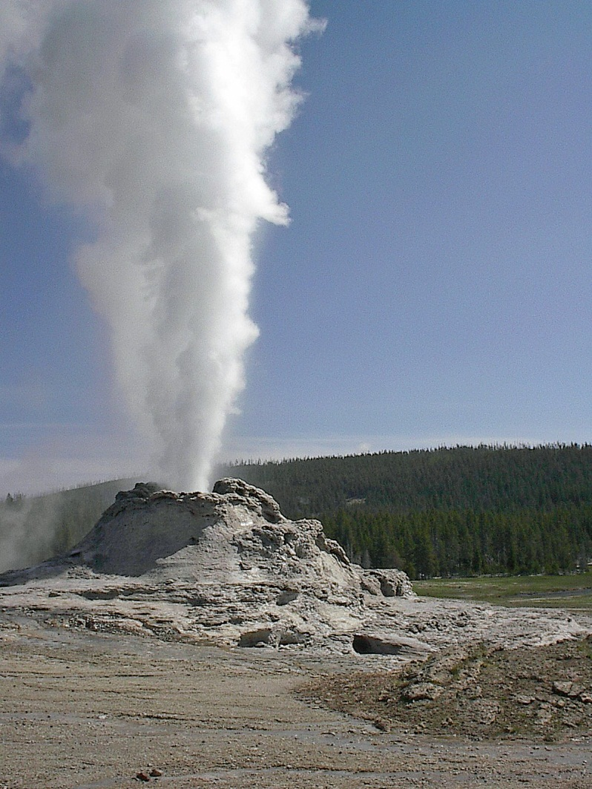
GEO THERMAL
Geothermal energy is the energy which lies embedded within the earths crust. There is an increase in temperature of the earth with increasing depth below the surface.
All the heat is stored in the earth’s crust and thermal energy constitutes inexhaustible source of energy termed as geothermal energy.

Slide 46
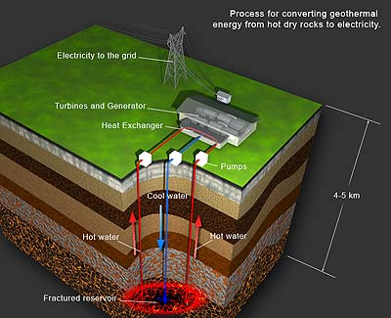

Slide 47
2 Main uses of Geothermal Energy:
Geothermal power plants are generally built where geothermal reservoirs are located with in a mile or two of the surface.
Geothermal heat pumps use stable ground or water temperature near the earth’s surface to control building temperatures above ground.

Slide 48
TIDAL ENERGY
THE PERIODIC RISE AND FALL, CALLED A TIDE, CAN BE USED TO PRODUCE ELECTRIC POWER WHICH IN THIS CASEIS MKNOWN AS TIDAL POWER.
THE TIDAL POWER POTENTIAL IN INDIA IS ESTIMATED TO ABOUT 15000 MW
THE POTENTIAL SITES ARE GULF OF CAMBAY 7000 MW GULF OF KACHCHH 1000 MW AND SUNDERBANS 1000MW
OTHER SUITABLE SITES ARE LAKSHADWEEP ANDAMAN & NICOBAR ISLANDS TAMILNADU ,KERALA, ORISSA AND MAHARASHTRA .

Slide 49
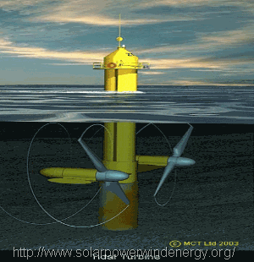

Slide 50
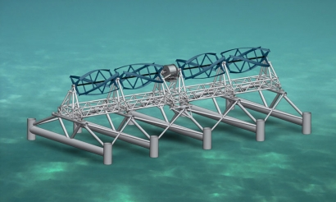

Slide 51
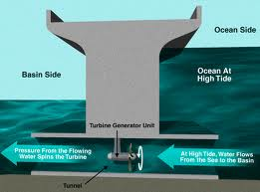

Slide 52
PROBLEMS DUE TO OVERUSE OF ENERGY RESOURCES
Due to population explosion, rapid industrialization and most importantly man’s unending desire to increase his comfort levels and living standards, the utilization rate of all the energy resources like coal, crude oil, etc is increasing by leaps and bound. This over use can cause some serious environmental, technological, economical and ecological problems.

Slide 53
IMPORTANT PROBLEMS DUE TO OVER USE OF ENERGY RESOURCES
Extinction of Resources.
Excessive mining of minerals.
Pollution.
Economical Effect.
Need of development of new technology.

Slide 54

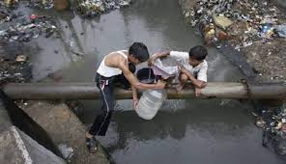

Slide 55
End of slideshow!
GRACIAS….!!!

